Slide 1
Introduction to the Web & HTML Basics
Web Development Essentials - Session 1

Slide 2
Course Overview
Welcome to Web Development Essentials
Course duration: 8 weeks
Topics: HTML, CSS, JavaScript basics
Focus: Building the foundations of web development
Learning Outcomes for Today's Session
Understand how the web works
Learn the basics of HTML and its structure
Create your first webpage

Slide 3
How the Web Works
Client-Server Model
Client: Your web browser (e.g., Chrome, Firefox)
Server: Stores and serves websites (e.g., Google servers)
Request/Response: Client sends a request, server sends back a response (HTML, CSS, JS)
Web Protocols
HTTP/HTTPS: How data is transferred across the web
URL: The address for a webpage

Slide 4
Introduction to Web Technologies
HTML (HyperText Markup Language)
The structure and content of web pages
CSS (Cascading Style Sheets)
Styling and layout of web pages
JavaScript
Adding interactivity to web pages

Slide 5
Development Environment Setup
Tools You’ll Need:
Code Editor: VS Code (recommended)
Browser: Chrome, Firefox, etc.
Developer Tools: Inspecting elements, console for JavaScript
Installing VS Code (Quick Walkthrough)

Slide 6
What is HTML?
Definition: HTML is the standard markup language for creating web pages.
HTML Elements: Tags that define the structure and content (e.g., <h1>, <p>, <a>)
Anatomy of an HTML Element:
<tagname> Content </tagname>
Example: <p>Hello World!</p>

Slide 7
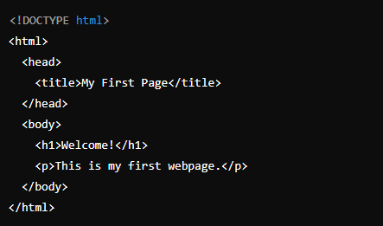
Basic Structure of an HTML Document
The Basic Skeleton:
Doctype: Defines the document type
HTML Tag: Wraps the entire content
Head: Contains metadata (e.g., title, links)
Body: Contains the visible content

Slide 8
Common HTML Tags
Headings: <h1> to <h6> (Defines titles and subtitles)
Paragraph: <p> (Defines blocks of text)
Links: <a href="url"> (Hyperlinks)
Images: <img src="url" alt="description">
Lists:
Ordered list: <ol>
Unordered list: <ul>

Slide 9
Creating Your First Webpage
Live Demo:
Open VS Code
Create a simple HTML file (index.html)
Add basic structure
Save and open in browser to view your first webpage
Sample HTML:

Slide 10
Hands-On Activity
Goal: Create a basic HTML page with a heading, and paragraph.
Adding heading <h1> and paragraph <p>
Save and view it in your browser
Share Your Work: Show your code to the instructor if you need help!

Slide 11
Summary
What We Learned Today:
The basics of how the web works
HTML structure and elements
Created our first webpage

Slide 12
Questions?
Q&A Session
Any questions before we wrap up?
Thank You & See You in the Next Class!

